Slide 1
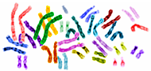





Where are the bad guys?
Genome wide association studies

Slide 2
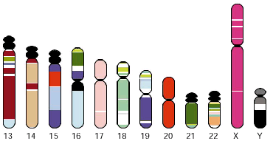
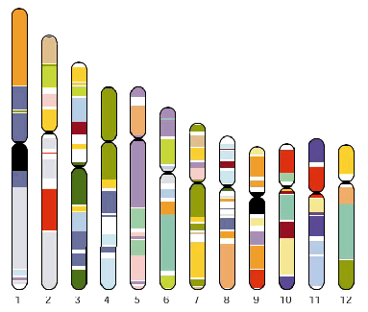
The human genome
~3,300,000,000 base pairs (~2 meter DNA in a single cell)
20,000-25,000 genes
Only few genes have a known function Many additional regulatory regions

Slide 3

Learning goals
After my introduction you are able to
Explain why genome wide association studies are being performed
List the prerequisits of a genome wide association study
Design a genome wide association study for an arbitrary trait

Slide 4
Disease mechanisms
Genetics
Invariable over time
Invariable over tissues
Almost all traits have a genetic component
Potential insight in
Biology and mechanisms
Potential drug targets
Potential stratification of individuals according to lifetime risk
Potential stratification of patients according to the most effective treatment
Lifestyle
Living environment
Life events
Disease

Slide 5
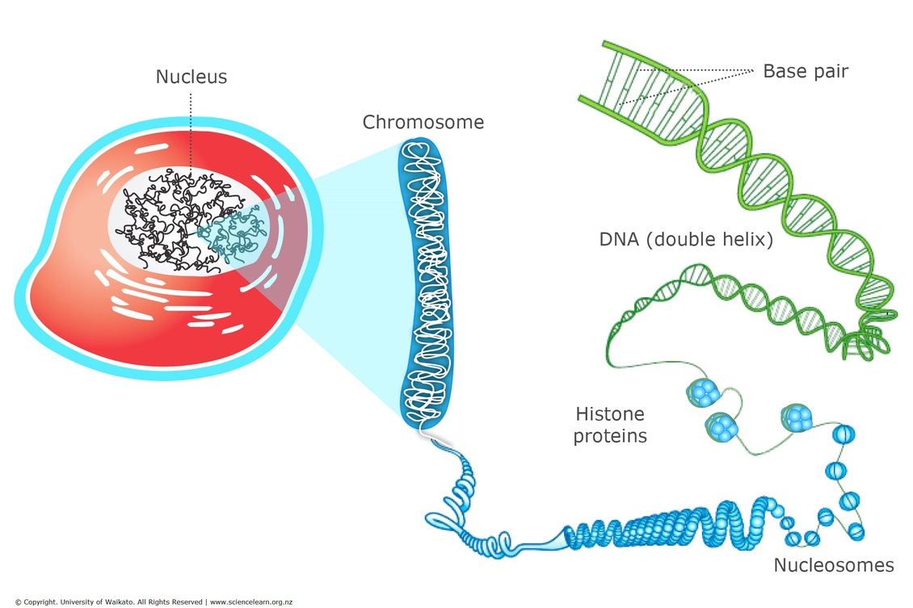
Desoxyribo Nucleic Acid

Slide 6
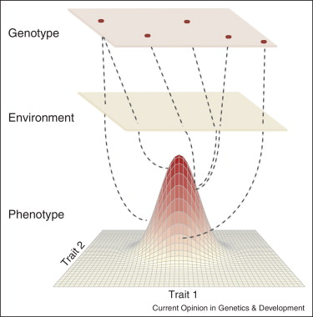
Heritability of a trait
How large is the contribution of the genotype in a trait?
The size of the genetic component is not related with the amount of loci.

Slide 7
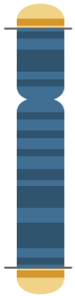
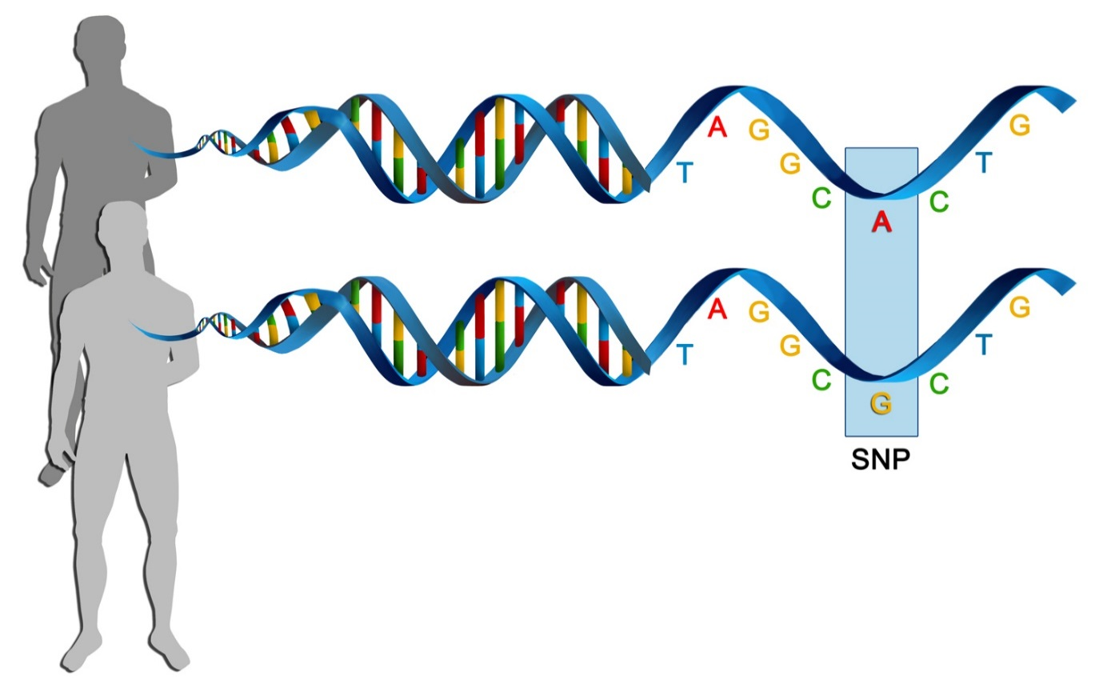
Single Nucleotide Polymorphism
Paternal allele
Maternal allele
Paternal allele
Maternal allele

Slide 8
Genetic variation
Chromosome pairs Paternal Maternal
C
T
Genotype
SNP rs429358 19:44,908,684
SNP rs7412 19:44,908,822
C
T
Haplotype
Notes:
138 basebairs away

Slide 9
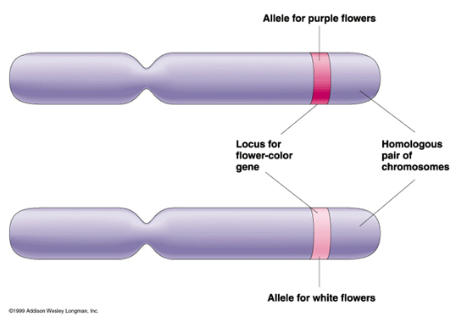
Genetic variation
Genotype
Consists of 2 alleles

Slide 10
Case – Control study (qualitative trait)
Controls
Cases
Genotype
AA
GA
GG

Slide 11
Biomarker study (quantitative trait)
Population
Low
High
Genotype
AA
GA
GG

Slide 12
Prerequisites for genetic association study
Trait:
Genetic component
Population
Sample size
Genetic variation
Minor Allele Frequency
Biological relevance,
not necessarily prediction
Study sizes assuming Power=80%, P=0.05

Slide 13
Genome wide genetic association study
Trait:
Genetic component
Population
Sample size
Genetic variation
Minor Allele Frequency
Genome wide genetic variation
SNP consortia
HapMap
Pilot 1000genomes

Slide 14
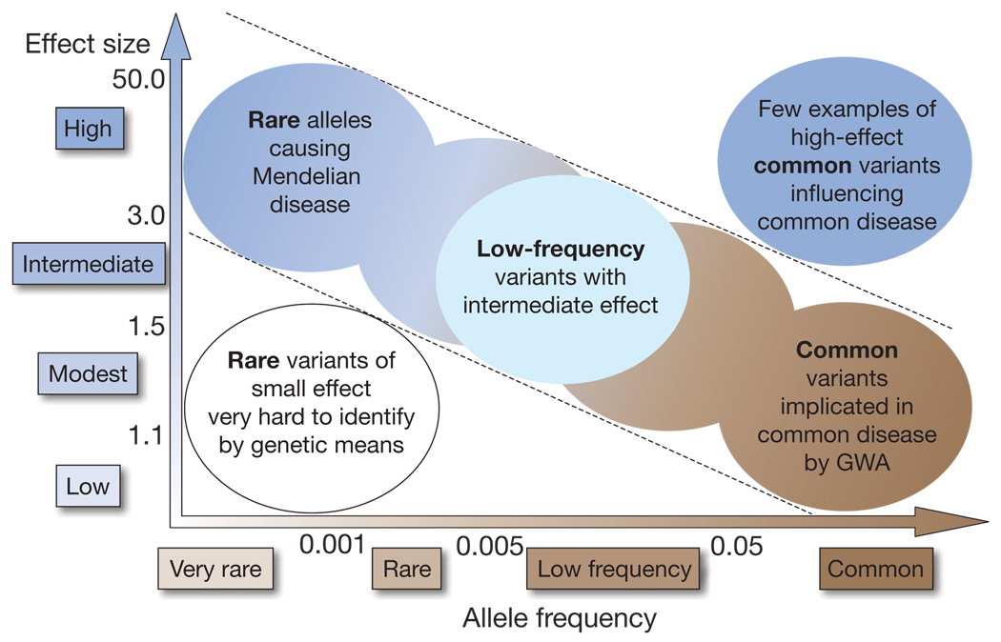

Minor allele frequency and effect size

Slide 15
Prerequisites for GWAS
Trait with an assumed/established genetic component
Large population in which trait and genetic variation has been measured
Formation of large consortia
Genetic variation
Common variants (MAF > 1%)
Localization of genetic variation
Technology
Statistics and informatics

Slide 16
Some bad guys…

Slide 17
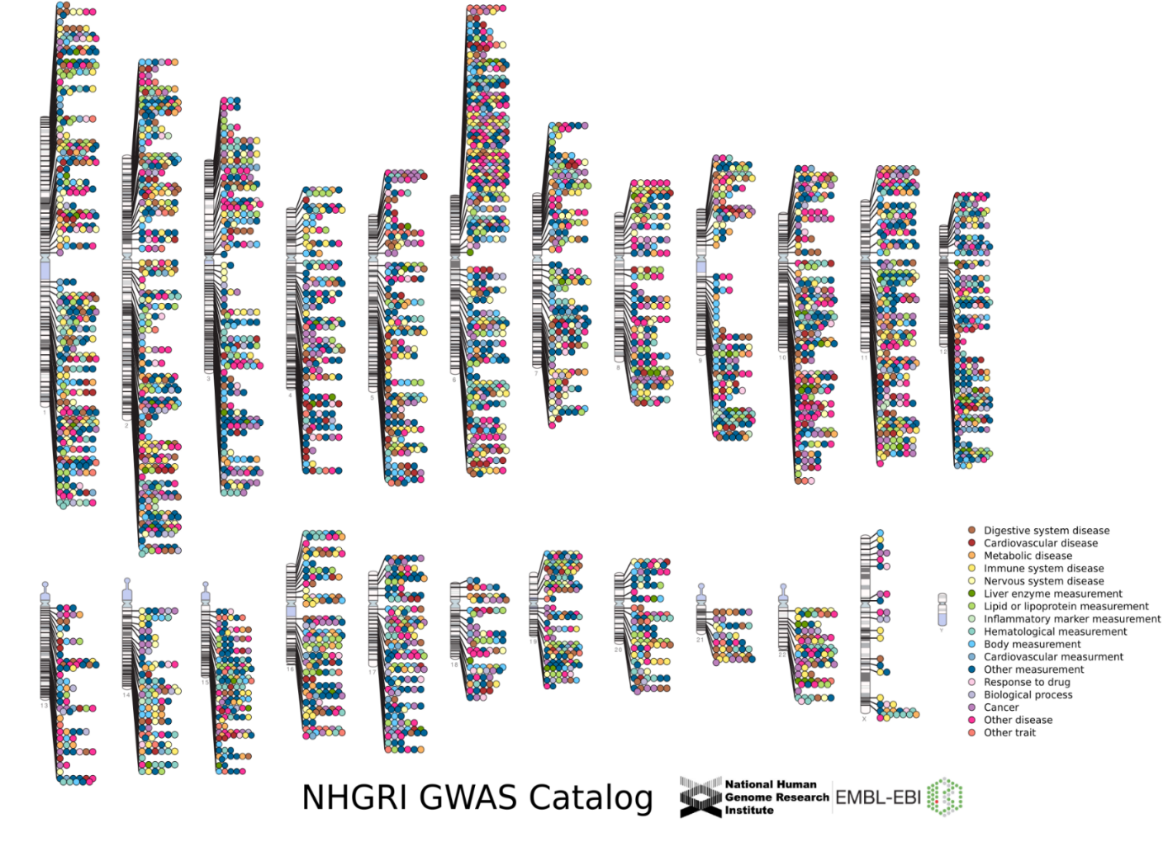

…have been identified

Slide 18
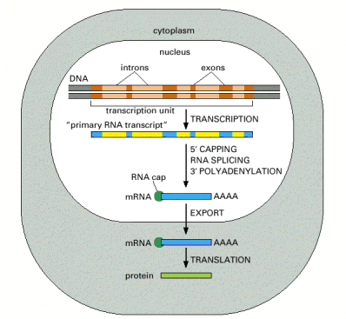
Biological effects of genetic variants
Gene expression
Stop codon
Splicing: e.g exon skipping
Binding miRNA: stability
Changes in silent 3rd base: stability mRNA
Wrong amino-acid

Slide 19
Prerequisites for GWAS
Trait with an assumed/established genetic component
Large population in which trait and genetic variation has been measured
Formation of large consortia
Genetic variation
Common variants (MAF > 1%)
Localization of genetic variation
Technology
Statistics and informatics

Slide 20
Learning goals
After the second part you are able to
Interpret linkage disequilibrium
Explain the difference between D’ and R²
Understand the principle of genetic imputation

Slide 21
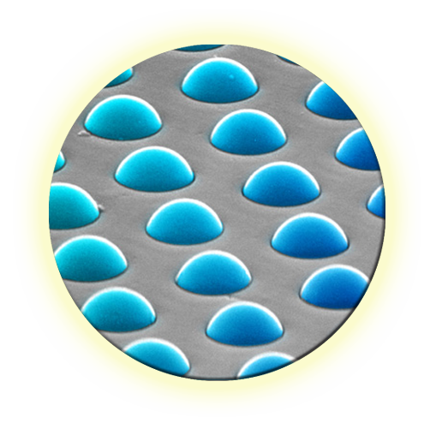

Genotyping technology
Illumina Human OmniExpress
~700k common SNPs
Copy Number Variations (CNV)
Very high data quality (call rate 99.84%)
Reasonable throughput (12 samples per chip)
Cost ~€ 200-300 per sample all in
Other Illumina chips up to 2.5M SNPs

Slide 22
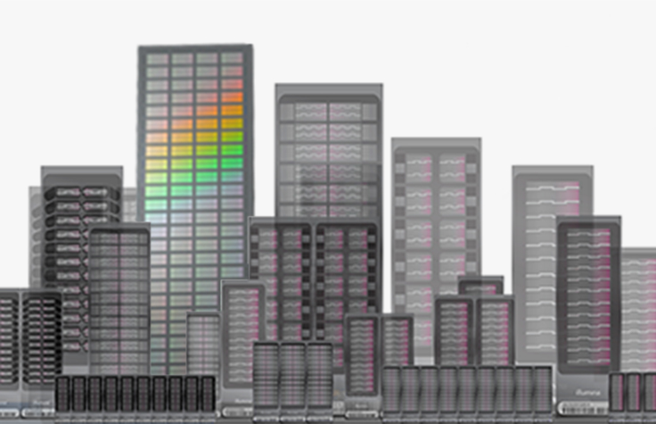
Genetic variation: Genotyping Illumina Infinium Beadchip technology

Slide 23
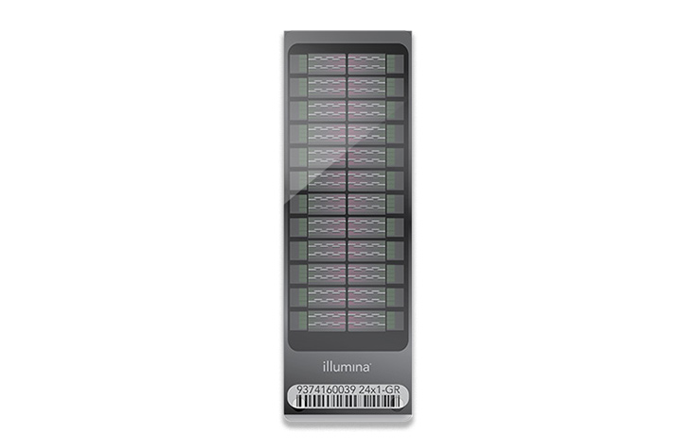
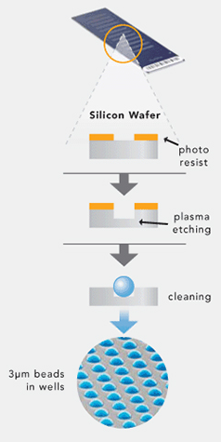
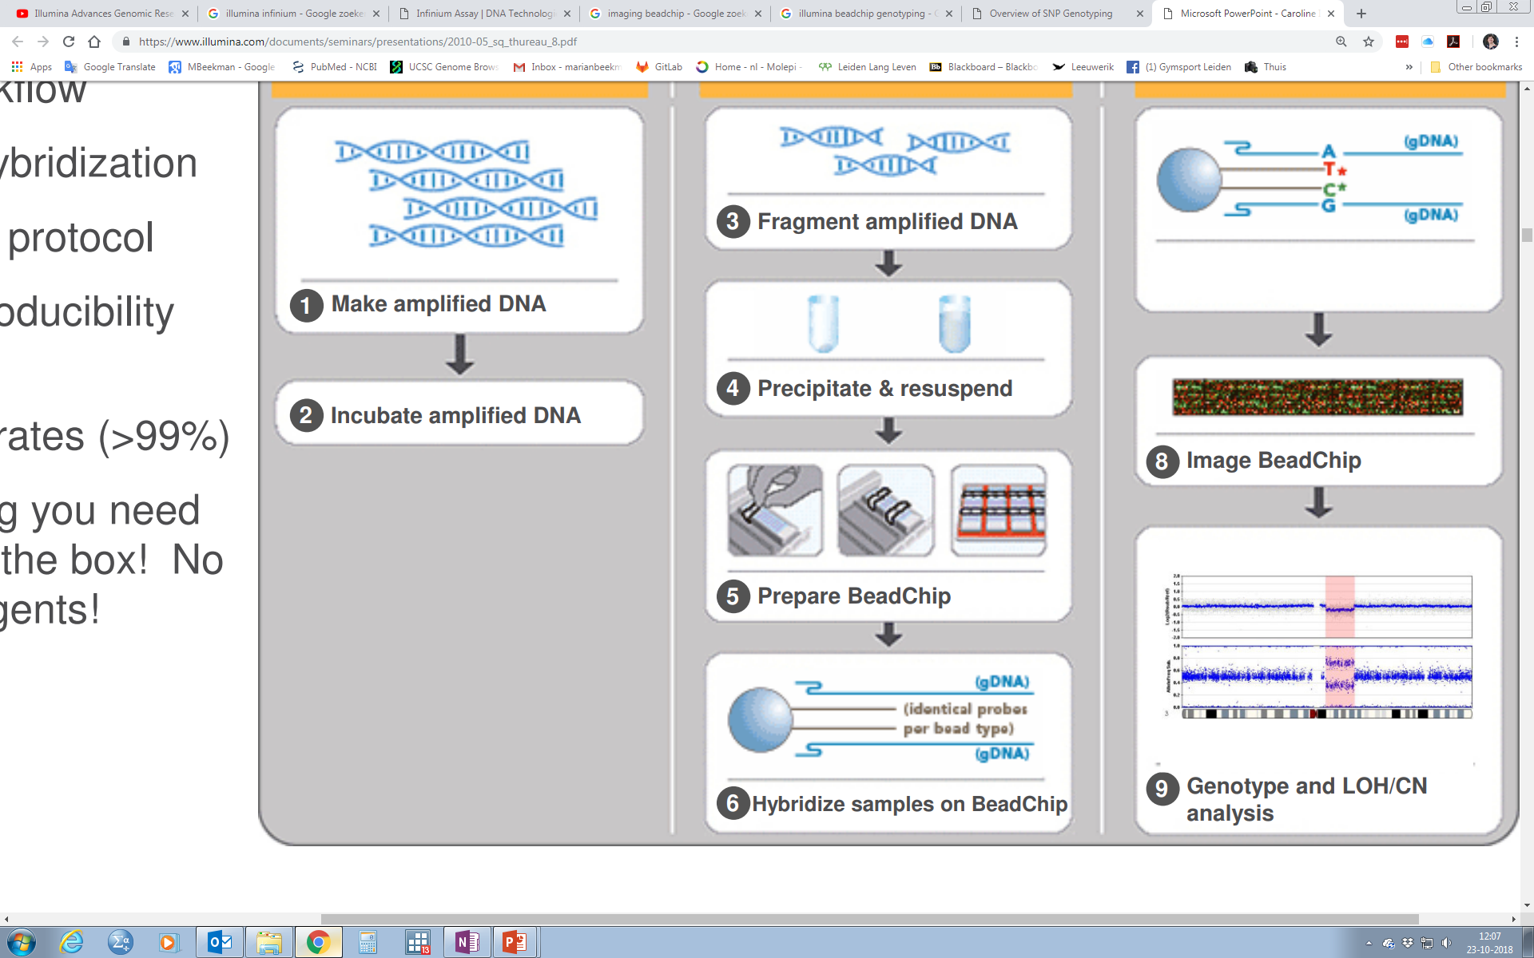
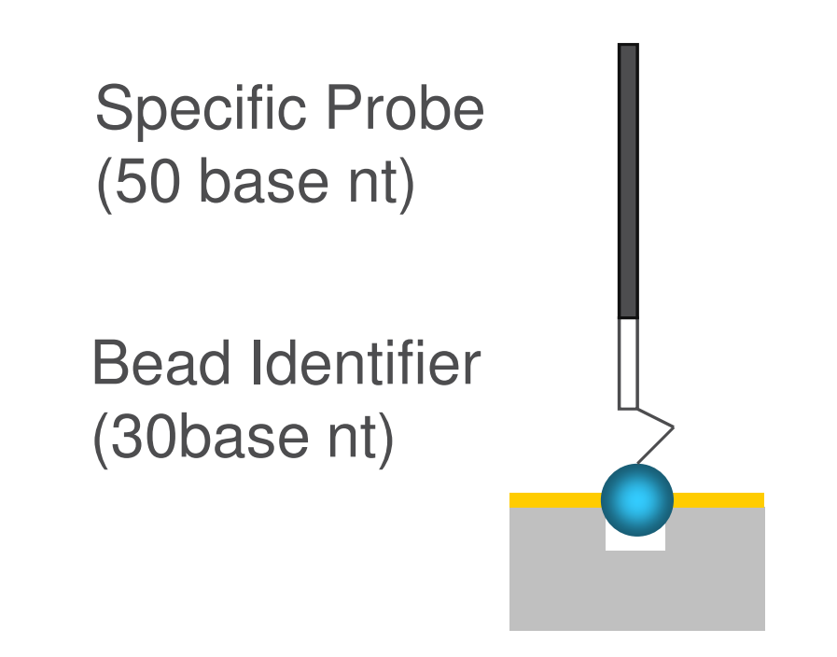

Genetic variation: Genotyping Illumina Infinium Beadchip technology

Slide 24
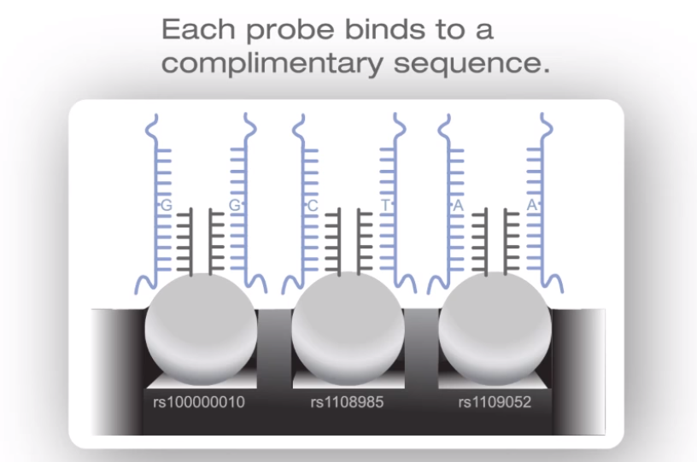
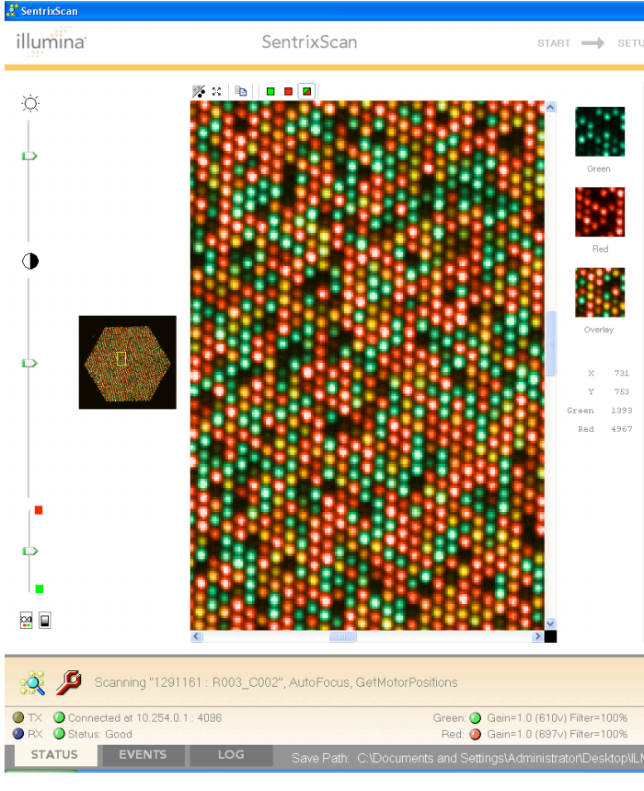
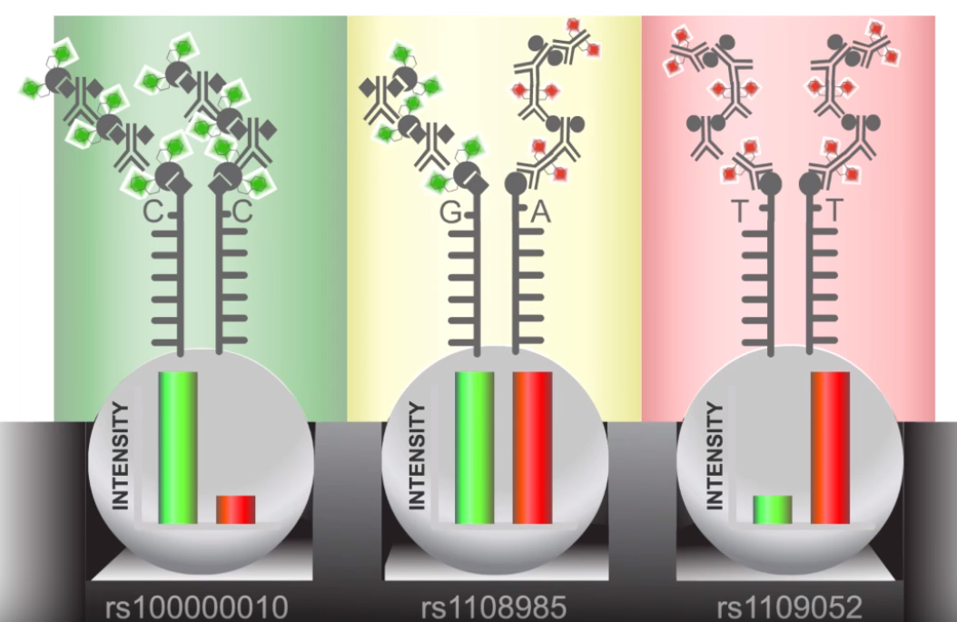
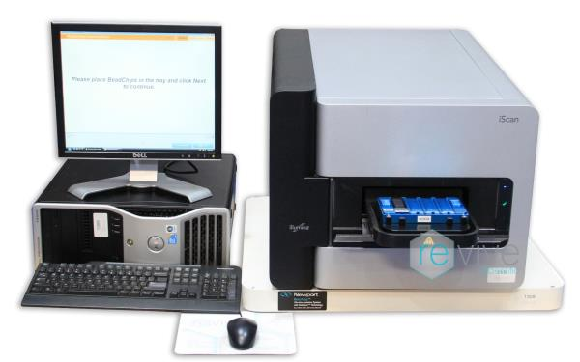
Genetic variation: Genotyping Illumina Infinium Beadchip technology

Slide 25
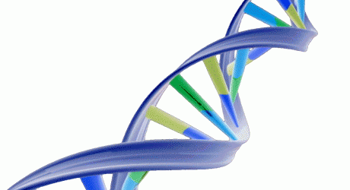
Indirect approach of association
Test all common genetic variation…
…by genotyping a small subset of SNPs only (efficient!)
Exploit ‘linkage disequilibrium’

Slide 26
Indirect approach of association
Two SNPs
A/G with MAF=0.40
C/T with MAF=0.20
Expectation combinations
A-C: 0.60x0.80=0.48
A-T: 0.60x0.20=0.12
G-C: 0.40x0.80=0.32
G-T: 0.40x0.20=0.08
Frequently this does not hold for close by SNPs:
→ DISEQUILIBRIUM

Slide 27
Indirect approach of association
Exploit linkage disequilibrium
A
C
Mutation 1
Time
A
C
G
C
Mutation 2
A
C
G
C
G
T
A
C
Recombination
G
T
A
C
G
C
G
T
A
T

Slide 28
Indirect approach of association
If no recombination:
A
C
D’=1
5’ SNP proxy for 3’ SNP
(hence: indirect)
Time
A
C
G
C
A
C
G
C
G
T
A
C
G
T
A
C
G
C
G
T
A
T

Slide 29
Indirect approach of association
If also equal allele frequencies:
A
C
r²=1
Perfect proxies
Time
A
C
G
C
2 mutation events
at same time?
A
C
G
C
G
T
A
C
G
T
A
C
G
C
G
T
A
T

Slide 30

International HapMap project
Samples HapMap phases 1+2
Yoruba, Nigeria (YRI):
n=90 (30 parent-offspring trios)
Ceph - Utah, USA (CEU):
n=90
Han Chinese, Beijing (CHB) + Japanese, Tokyo (JPT):
n=90
Genotyping
6,349,188 suspected SNPs assessed
2,819,322 indeed polymorphic and MAF>0.05
No resequencing done but ENCODE regions (10 x 5Mb) sequenced as reference
HapMap consortium, Nature 2005&2007

Slide 31
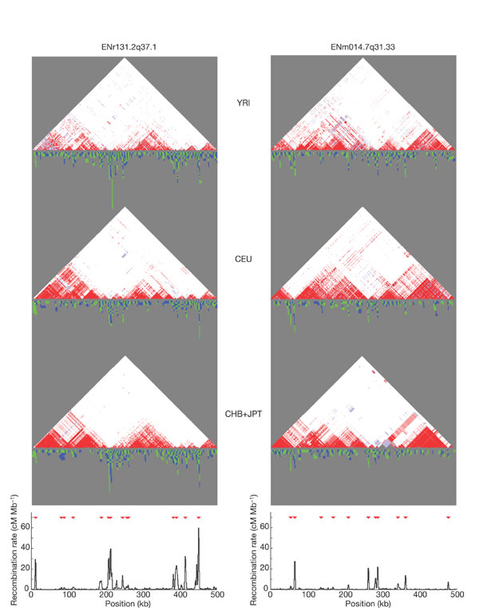
Genetic variation is limited
Red=D’
D’=1 but r²<1
LD across blocks

Slide 32
Genetic imputation
Prediction of missing genotypes using LD
A
C
G
Occuring haplotypes
known from Reference Panels
G
T
G
G
C
C
Measured in GWAS
Predicted genotype

Slide 33
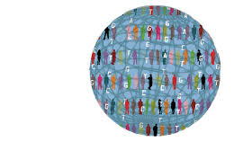
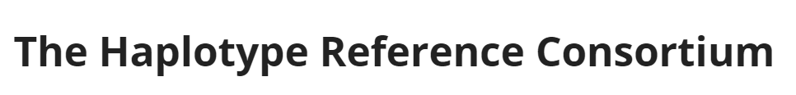
Imputation Reference Panels
International HapMap project (2007)
CEU (European), YRB (African), JPT/CHB (Asian)
270 samples
~2.5M SNPs
1000 Genomes Project (2010)
EUR (European), AFR (African), ASN/SAN (Asian), AMR (Americas)
2,535 samples
~30M SNPs + Indels
The Haplotype Reference Consortium (2015)
Mainly EUR ancestry
32,611 samples
39.2 M SNPs

Slide 34
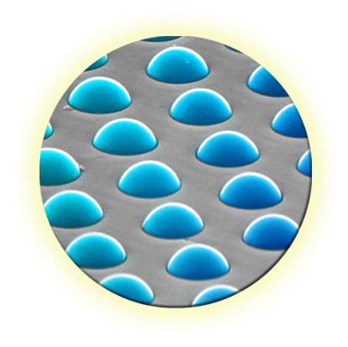

Genetic variation: Genotyping and imputation
Illumina Global Screening Array (GSA) array
~640k common SNPs
Very high data quality (call rate 99.84%)
High throughput (24 samples per chip)
Cost ~€ 50 per sample all in
=> Haplotype Reference Consortium imputation up to 40 Million SNPs!

Slide 35

HELP!
I generated 400 billion data points
40,000,000 SNPs
10,000 individuals

Slide 36
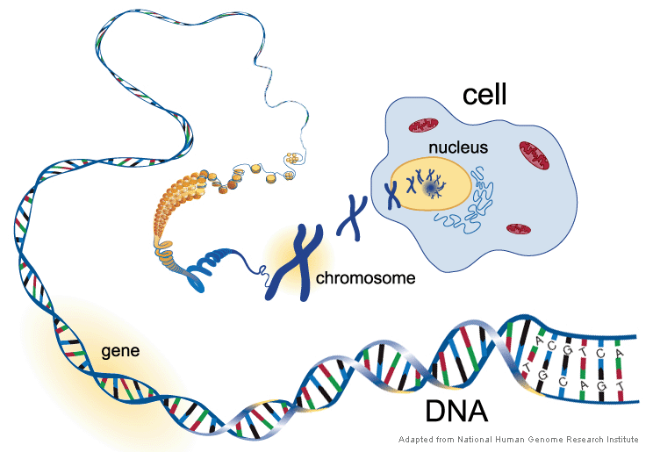
Practical
Genome-wide association study (GWAS)
Measure single nucleotide polymorphisms (SNPs)
300,000 – 40,000,000 SNPs

Slide 37
Practical
Investigate whether different genotypes are associated with different levels of a biomarker
Successful approach for many complex diseases/traits
Population
Low
High
Genotype
AA
GA
GG

Slide 38
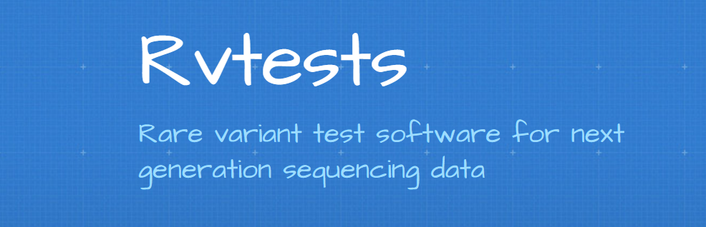
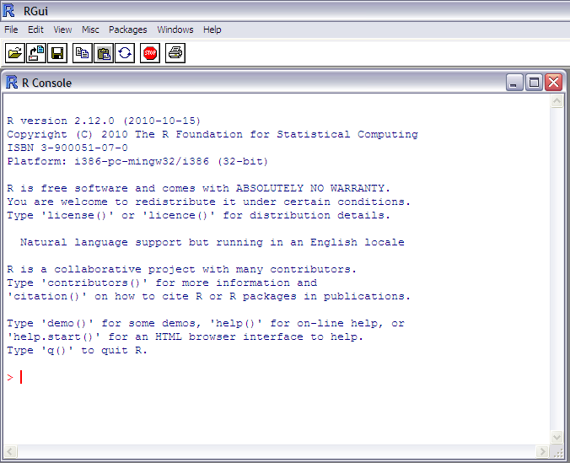
Conquer your fear of The Blinking Cursor
R
Explore input files
Demo by Dina Vojinovic
Explore and visualize results

Slide 39


Slide 40
Hardy Weinberg Equilibrium
HWE is used to check the genotyping quality in GWAS analyses
Allele frequencies should correspond with genotype frequencies
Example SNP rsXX has 2 alleles: A with a frequency of 0.8 G with a frequency of 0.2

Slide 41
Hardy Weinberg Equilibrium
A= 0.8 is represented by p B = 0.2 is represented by q
=> p+q=1
From allele frequencies the genotype frequencies can be calculated.

Slide 42
Hardy Weinberg Equilibrium
Formula of Hardy-Weinberg Equilibrium: AA=p² AG=2pq GG=q²
In this case: AA=0.8*0.8= 0.64 AG=2*0.8*0.2=0.32 GG=0.2*0.2=0.04
NB: under the assumption of random mating

Slide 43
Hardy Weinberg Equilibrium
HWE test:
Genotypes | Observed N | Expected N | (obs-exp)²/exp
AA | 60 | 64 (p² * 100) | 0.25
AG | 20 | 32 (2pq * 100) | 4.5
GG | 20 | 4 (q² * 100) | 64
Total | 100 |  | Chi²=68.75
A frequency | 0.8 |  | Df=1 | P<0.05
G frequency | 0.2

Slide 44
Learning goals
After this third part you are able to
Explain the principles of a genetic association analysis
Apply adjustment for multiple testing in genome wide association studies
Understand the importance of large sample size and replication of results

Slide 45
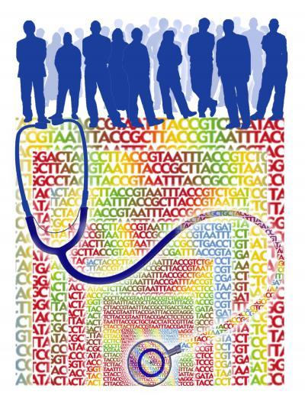
Statistical Analysis
Keep it simple
Single SNP analysis
Easy to interpret
Minimal number of tests
All very basic statistical tests (Χ² or similar)

Slide 46
Statistical Analysis
Cochrane-Armitage trend test
Same as linear-by-linear in SPSS
Additive effect: more risk alleles, more effect
Genotype coding: 0, 1, 2 (counting no. of rare alleles)
Plausible biological model
Robust against random fluctuations
Optimal power (df=1)

Slide 47
Regression analysis
Trait ~ Constant + β₁ x SNP
Where the dependent variable “Trait” is
Quantitative trait => linear regression
Case-Control status => logistic regression
And where the independent variable “SNP” is coded as number of alternative alleles (0, 1 or 2)
Cochrane Armitage Trend test H0: β₁ = 0, No association
ASSOCIATION if β₁ is NOT EQUAL to 0

Slide 48
Alternatives
Recessive test
Mendelian disease like Cystic Fibrosis
Assumes effect among rare homozygotes only

Slide 49
Alternatives
Dominant test
Mendelian disease like Huntington’s Disease
A single rare allele is sufficient for disease trait
Common homozygotes and heterozygotes same effect
Often trend test has sufficient power

Slide 50
What if

Slide 51
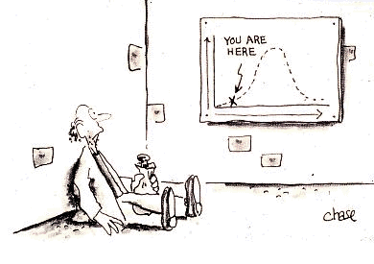
Significance in GWAs
Consensus on genome-wide significance in GWAs
1 million independent tests
P < 5x10⁻⁸ (0.05/10⁶)
But ignores ‘enrichment’ for low p-values

Slide 52
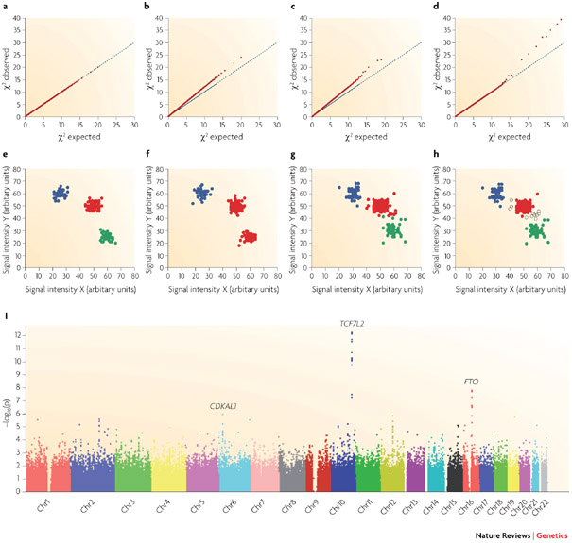
Bias and enrichment
QQ plots allow to detect bias and enrichment for low p-values

Slide 53
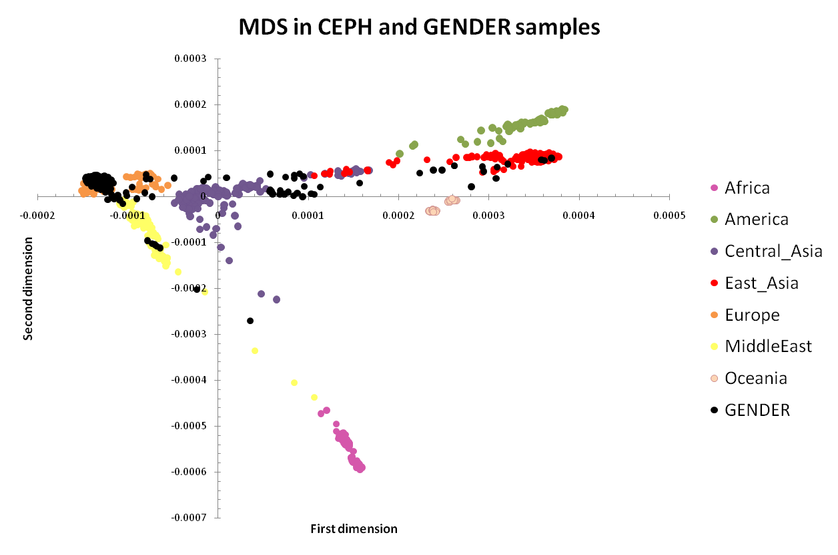
Prevent population stratification
Detect heterogeneity in origin of participants by comparing genotyping results to HapMap data
Sampietro et al. Hum Mol Genet. 2011 Dec 1;20(23):4748-57
Notes:
Sampietro et al. Hum Mol Genet. 2011 Dec 1;20(23):4748-57
Supplementary Figure1: Multidimensional Scaling (MDS).
This plot displays samples from the GENDER study together with HGDP-CEPH samples. On the x-axis, the first dimension of the MDS is depicted and on the y-axis the second. CEPH individuals are grouped by continental region. In pink Africa, in green America, in purple Central-Asia, in red East-Asia, in orange Europe, in yellow Middle-East, in brown Oceania and in black the GENDER population.

Slide 54
Visualization
Manhattan plots are standard way to display GWAS results

Slide 55
Not all is fancy
Check cluster plots of identified SNPs
Association of multiple SNPs (in LD) may be considered technical validation

Slide 56
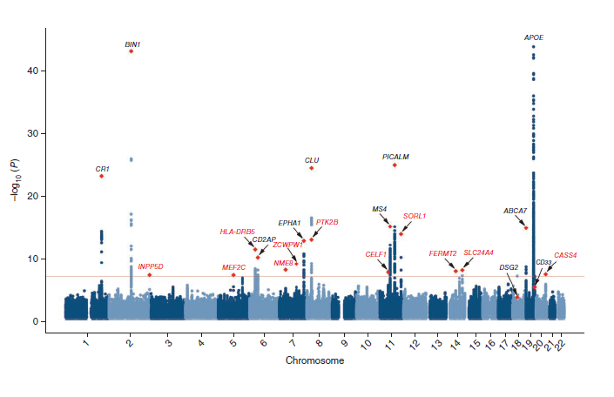
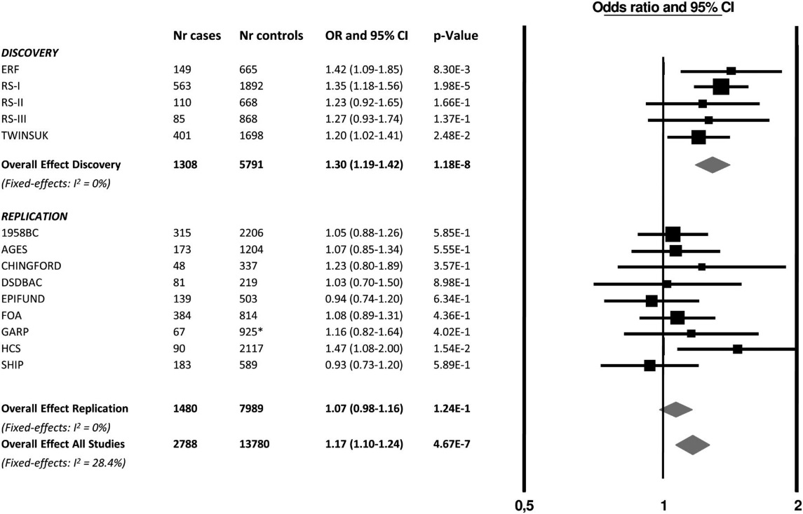
State of the art Meta-GWAS
Combine multiple GWAS (n > 50,000)
Follow-up in multiple cohorts (n > 50,000)
Genome wide significant loci (P<5x10-8)
17,000 late onset Alzheimer disease patients vs
37,000 controls
Lambert et al Nat Genet 2014
Notes:
Lambert et al Nat Genet 2014 :
Meta-analysis of 74,046 individuals identifies 11 new susceptibility loci for Alzheimer’s disease
Genetic risk score
Speliotes et al: Nature Genetics 42, 937–948 (2010) doi:10.1038/ng.686

Slide 57

Replication
Without replication no one will believe you
Same SNP
Same allele
Same phenotype
Same genetic model
Considerations
Often ≥2 large replications required nowadays: collaboration is key
Replication in cohorts that do not have GWAS data available
Notes:
Lambert et al Nat Genet 2014 :
Meta-analysis of 74,046 individuals identifies 11 new susceptibility loci for Alzheimer’s disease
Genetic risk score
Speliotes et al: Nature Genetics 42, 937–948 (2010) doi:10.1038/ng.686

Slide 58
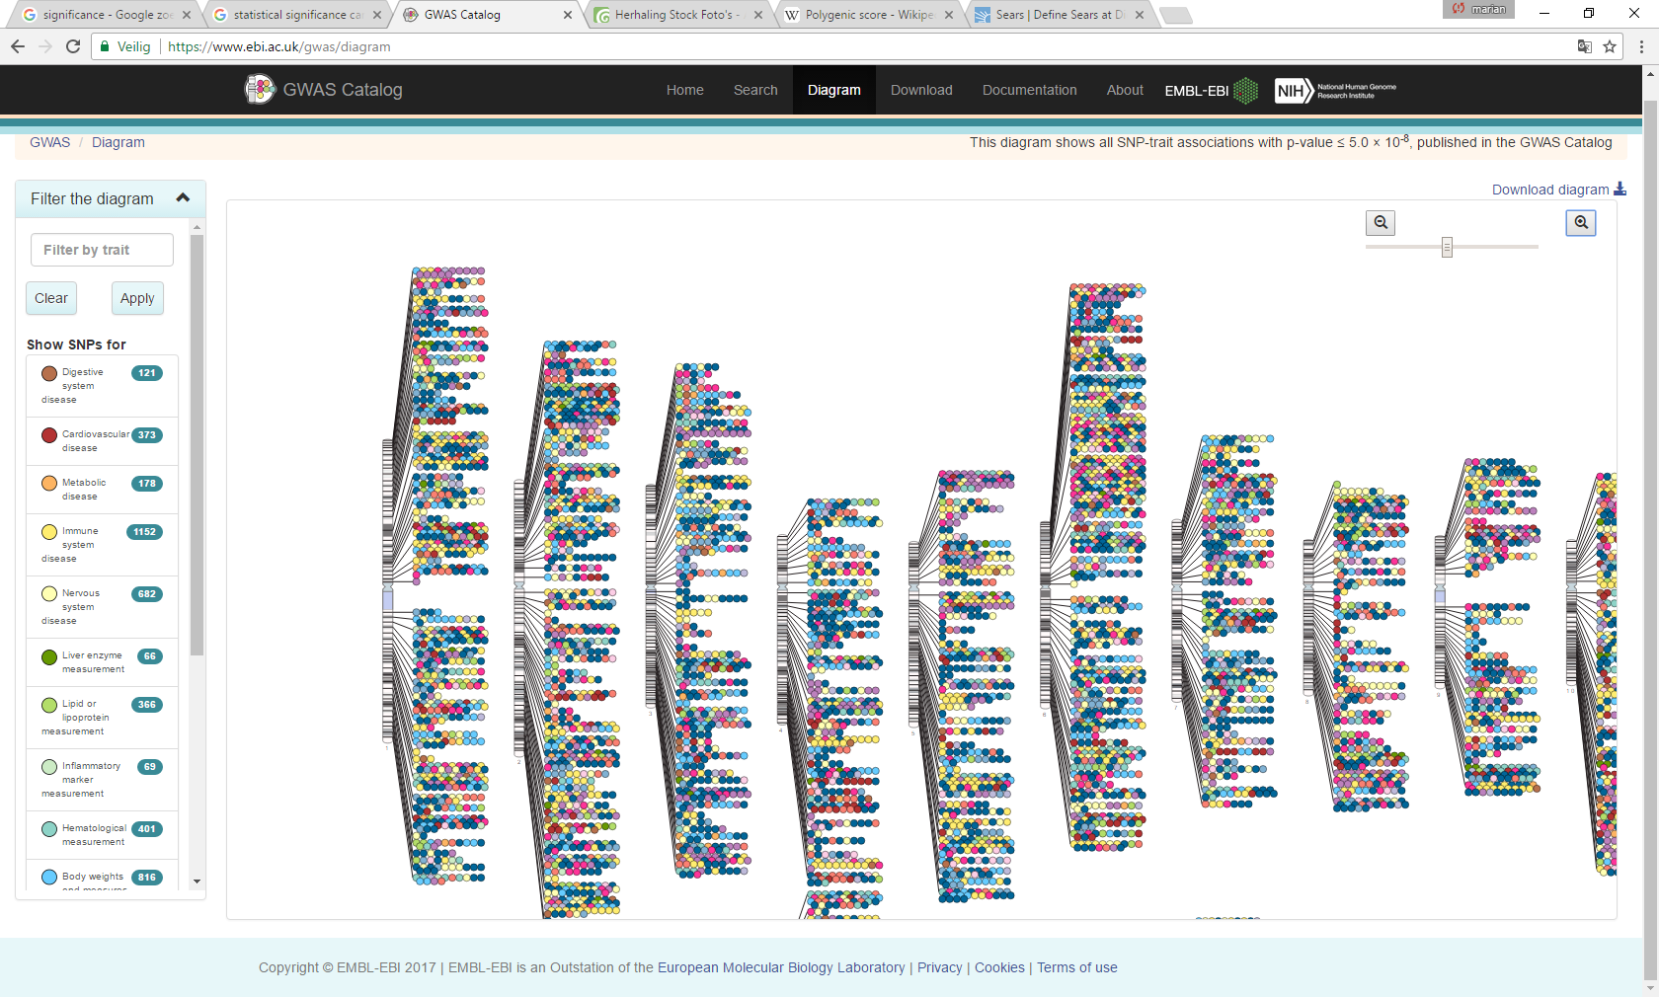
A Catalog of GWAS
Database of all GWAS results https://www.ebi.ac.uk/gwas/
19/06/2017: 2982 publications and 36,948 unique SNP-Trait associations P<10⁻⁸
Notes:
Lambert et al Nat Genet 2014 :
Meta-analysis of 74,046 individuals identifies 11 new susceptibility loci for Alzheimer’s disease
Genetic risk score
Speliotes et al: Nature Genetics 42, 937–948 (2010) doi:10.1038/ng.686

Slide 59
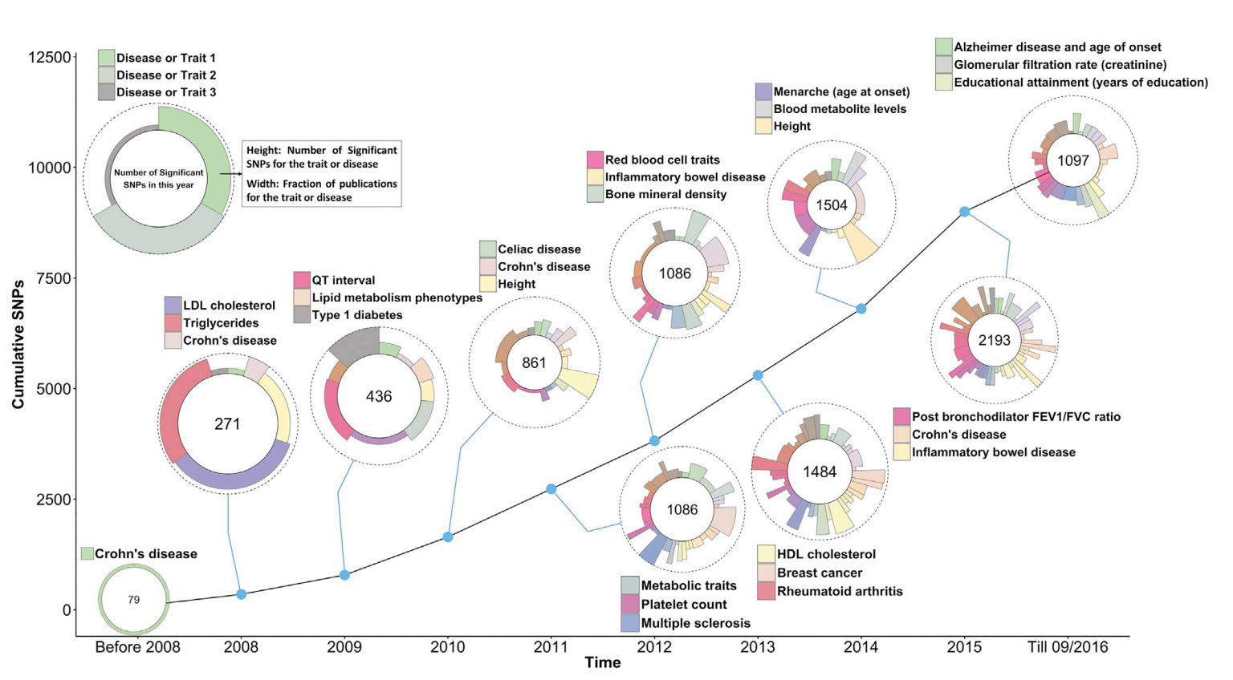
GWAS SNP-Trait discovery Timeline
Notes:
https://www.ncbi.nlm.nih.gov/pmc/articles/PMC5501872/pdf/main.pdf
GWAS SNP-Trait Discovery Timeline
Data used for generating the graph were taken from the GWAS Catalogue.¹⁰ SNPs and traits were selected according to the following filters. SNPs were selected with a p value < 5 × 10⁻⁸. For each trait with two or more selected SNPs, SNPs were removed if they had an LD r² > 0.5 (calculated from 1000 Genomes phase 3 data) with another selected SNPs and their p value was larger. For each year of discovery, only the top three traits and diseases with the largest number of SNPs are labeled in the circle.

Slide 60

BREAK
BREAK
BREAK
BREAK
BREAK

Slide 61
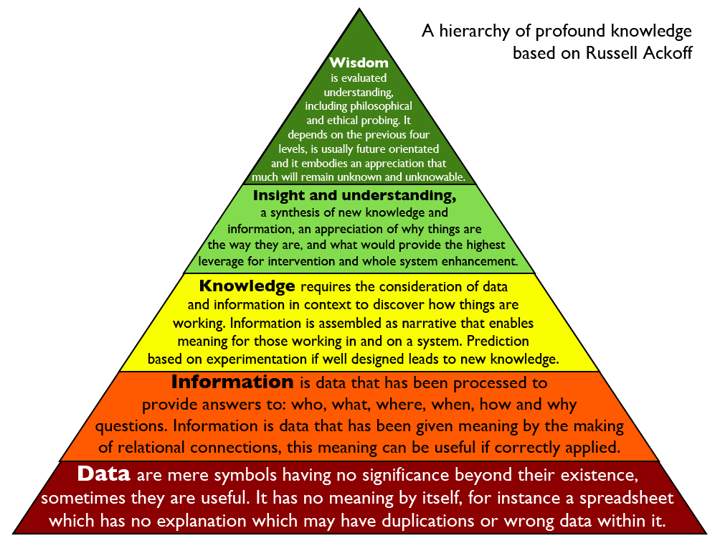

Slide 62
Learning goals
After this fourth part you are able to
Explain potential factors contributing to the missing heritability of traits
Understand that genetic loci associated with disease are no good predictors for disease
Provide an outlook how mechnisms underlying GWAS results may be investigated to establish causality

Slide 63
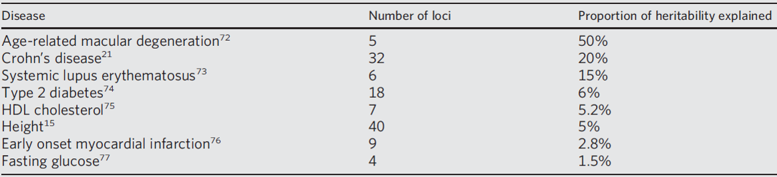
What we do not know after al those GWASes
Missing heritability

Slide 64
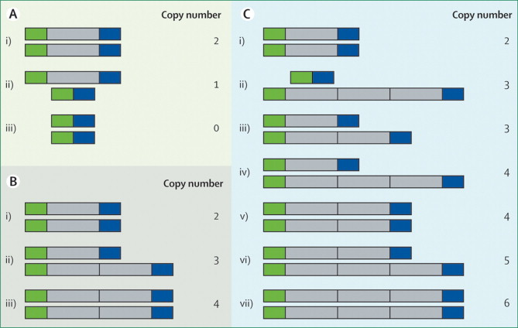
Incomplete detection genetic variation
Factors
Common SNPs missed with (previous) arrays
Structural variation, copy number variants, in/dels
Much fewer known than SNPs
Deletion
Copy Number Variation
Insertion
LV Wain et al. The Lancet 374 (9686):340-350 (2009)
Notes:
LV Wain et al. The Lancet 374 (9686):340-350 (2009)
Figure 1
Diallelic and multiallelic copy number variation
Diallelic locus (grey) and flanking loci (green and blue) with variation caused by (A) deletion and (B) duplication, each showing the locus with (i) normal copy number, (ii) heterozygous modification, and (iii) homozygous modification. (C) Multiallelic locus showing (i) normal copy number, (ii) multiple rounds of duplication on one chromosome and a deletion on the homologous chromosome, (iii) duplication on one chromosome and no deletion on the homologous chromosome, (iv) multiple rounds of duplication on one chromosome and no deletion on the homologous chromosome, (v) one round of duplication on each chromosome, (vi) one round of duplication on one chromosome and multiple rounds of duplication on the homologous chromosome, and (vii) multiple rounds of duplication on both chromosomes. Multiallelic assays measure diploid copy number and therefore cannot distinguish between (ii) and (iii), or (iv) and (v). Note that although duplications are usually assumed to be contiguous, this might not always be the case.

Slide 65
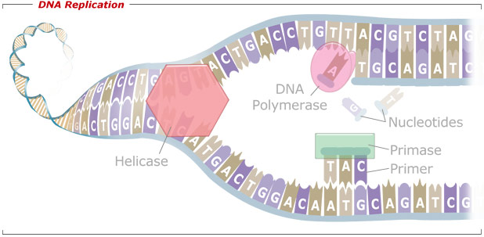
Incomplete detection genetic variation
Factors
Common SNPs missed with (previous) arrays
Structural variation, copy number variants, in/dels
Much fewer known than SNPs
Rare variants: Sequencing
Notes:
LV Wain et al. The Lancet 374 (9686):340-350 (2009)
Figure 1
Diallelic and multiallelic copy number variation
Diallelic locus (grey) and flanking loci (green and blue) with variation caused by (A) deletion and (B) duplication, each showing the locus with (i) normal copy number, (ii) heterozygous modification, and (iii) homozygous modification. (C) Multiallelic locus showing (i) normal copy number, (ii) multiple rounds of duplication on one chromosome and a deletion on the homologous chromosome, (iii) duplication on one chromosome and no deletion on the homologous chromosome, (iv) multiple rounds of duplication on one chromosome and no deletion on the homologous chromosome, (v) one round of duplication on each chromosome, (vi) one round of duplication on one chromosome and multiple rounds of duplication on the homologous chromosome, and (vii) multiple rounds of duplication on both chromosomes. Multiallelic assays measure diploid copy number and therefore cannot distinguish between (ii) and (iii), or (iv) and (v). Note that although duplications are usually assumed to be contiguous, this might not always be the case.

Slide 66
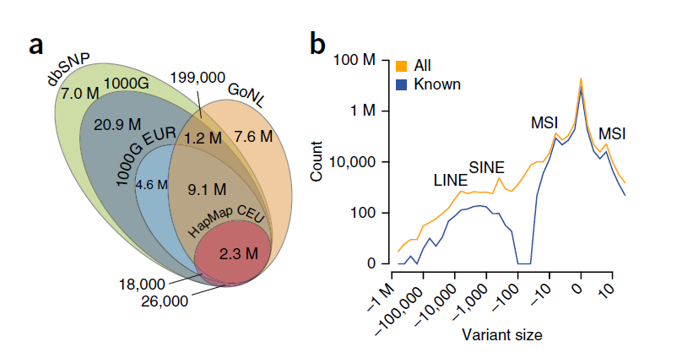
Current state-of-the-art
Genome of The Netherlands (Go.NL)
769 samples
~20M SNPs
Insertion and deletions (Indels)
L Francioli et al. Nature Genetics (2014)
Notes:
L Francioloi et al. Nature Genetics (2014)
Figure 1 Discovery of SNVs and structural variation. (a) Venn diagram of all SNVs discovered in GoNL relative to dbSNP (Build 137) and the 1000 Genomes Project (1000G) Phase 1 and HapMap CEU panels. The majority of the 7.6 million novel sites are rare (MAF < 0.5%), including 5.8 million singletons. M, million. (b) Size spectrum of structural variation discovered in GoNL. Our detection strategy employed multiple approaches and provided a significant boost in the identification of novel structural variants in the midsize range (30–500 bp). Peaks corresponding to long interspersed elements (LINEs), short interspersed elements (SINEs) and microsatellite instability (MSI) are highlighted. The total number of variants called in GoNL is shown in orange, whereas SNVs found in dbSNP (Build 137) and short indels and large deletions found in 1000 Genomes Project Phase 1 data are shown in blue. For large deletions (>20 bp), we required at least 80% reciprocal overlap between variants for them to be considered similar.

Slide 67
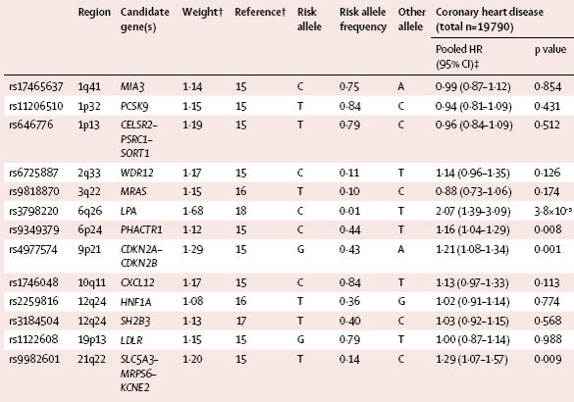
Prediction by single SNP
Limited or no prediction despite biological insight
Ripatti et al. Lancet (2010)
Notes:
Association between SNPs and incident coronary heart disease, cardiovascular disease, and myocardial infarction.
Laag Relatief risico en niet significante p-waarden.
30.000 mensen gevolgd voor 8 jaar en 1200 hadden CVD ontwikkeld

Slide 68
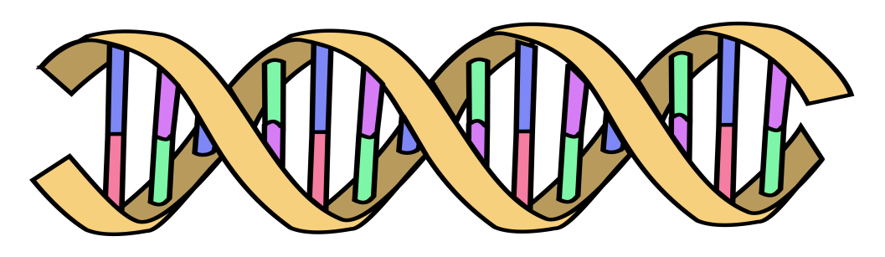
Prediction by Polygenic Risk Score
Polygenic Scores capture (part of) someone’s genetic “risk” by summing all risk alleles weighted by the effect sizes estimated in a Genome-Wide Association Study (GWAS)
1×-.02 + 2×.01 + 1×.002 + 0×.03 + 2×.025
Polygenic score:
AC
GG
CC
TT
.052
AT
Effect sized from GWAS
β_{C}=-.02
β_{G}=.01
β_{A}=.002
β_{G}=.03
β_{T}=.025

Slide 69
Prediction by Polygenic Risk Score
By summing the collective effect sizes of many SNPs you can quantify part of the genetic “risk” in an independent dataset
Polygenic Scores generally improve when adding SNPs that individually didn’t reach genome-wide significance

Slide 70
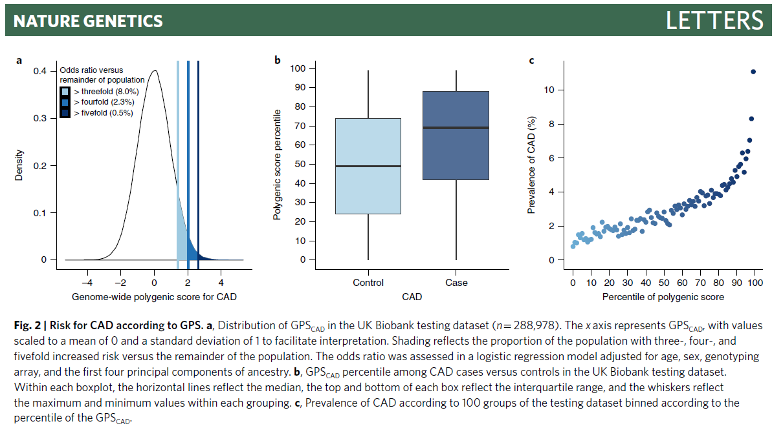
Prediction by Polygenic Risk Score
Notes:
https://doi.org/10.1038/s41588-018-0183-z Khera et al. 2018 Nature Genetics
Fig. 2 | Risk for CAD according to GPS. a, Distribution of GPSCAD in the UK Biobank testing dataset (n = 288,978). The x axis represents GPSCAD, with values scaled to a mean of 0 and a standard deviation of 1 to facilitate interpretation. Shading reflects the proportion of the population with three-, four-, and fivefold increased risk versus the remainder of the population. The odds ratio was assessed in a logistic regression model adjusted for age, sex, genotyping array, and the first four principal components of ancestry. b, GPSCAD percentile among CAD cases versus controls in the UK Biobank testing dataset. Within each boxplot, the horizontal lines reflect the median, the top and bottom of each box reflect the interquartile range, and the whiskers reflect the maximum and minimum values within each grouping. c, Prevalence of CAD according to 100 groups of the testing dataset binned according to the percentile of the GPSCAD.

Slide 71
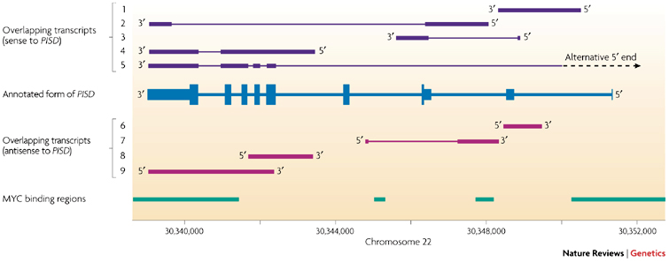
A gene is not what it used to be
Multiple use of same sequence
Phosphatidylserine decarboxylase (PSID)
Kapranov et al. Nat Rev Genet 2007 & ENCODE publications

Slide 72
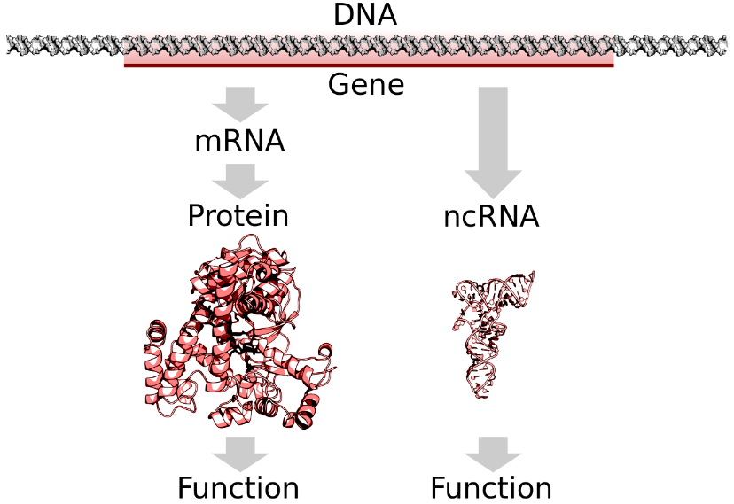
A gene is not what it used to be
Up to 90% of genomic DNA is transcribed
1-2% encodes exons, ~15% exons+introns
Alternative initiation of trancription: ~60%
Alternative TSS 10s-100s kb away
Encode: 90% of genes have unannotated exon/TSS
Alternative splicing: 60%
Transcripts with anti-sense counterpart: 60%
Alternative polyadenylation
Gene fusions
Trans splicing
RNA synthesis at enhancers (eRNA)
Relevant transcription factor binding occurs anywhere

Slide 73

Underlying Mechanism
Pathway analyses:
DAVID
Database for Annotation, Visualization and Integrated Discovery
Gene Functional Classification Tool Based on Gene Ontology
STRING
Search Tool for the Retrieval of Interacting Genes/Proteins
Known and predicted protein-protein interactions
DAPPLE
Disease Association Protein-Protein Link Evaluator
Physical connectivity among proteins encoded for by genes according to protein-protein interactions reported in the literature.

Slide 74
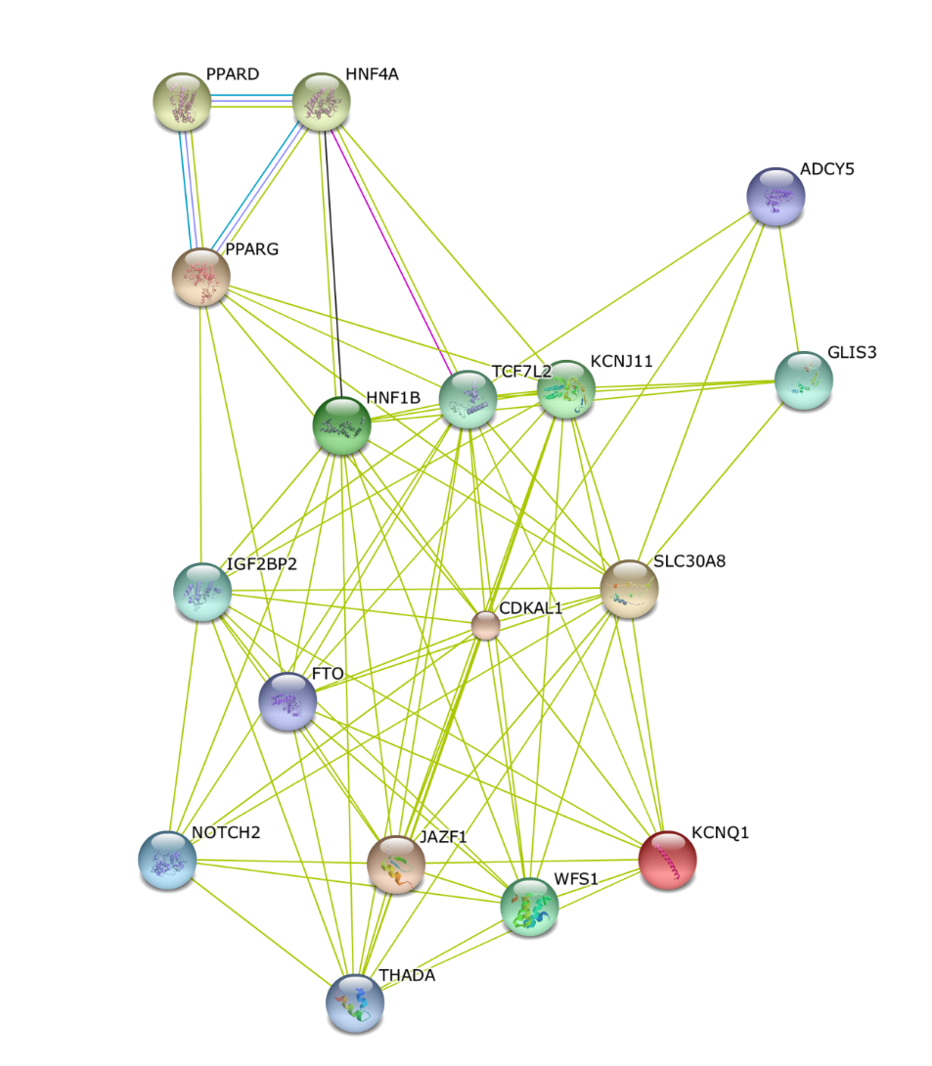
Underlying Mechanism
STRING

Slide 75
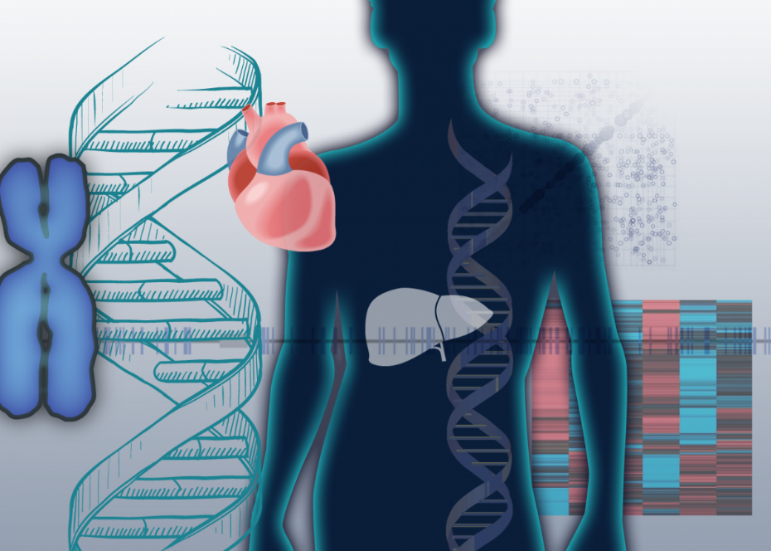

Causality
Combine knowledge from public databases using USCS genome browser
Databases with biological knowledge
ENCODE
Haploreg
Databases with functional knowledge
GTEX for eQTLs
Entrez Gene for gene functions

Slide 76
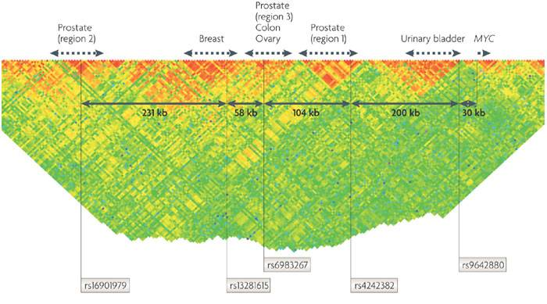
Truly novel findings
‘Gene deserts’
8q24 region confers susceptibility to various cancers
Functional studies are very much required
Notes:
John P. A. Ioannidis, Gilles Thomas & Mark J. Daly
Nature Reviews Genetics 10, 318-329 (May 2009)
Box 5 | Gene deserts: the 8q24 region and susceptibility to various cancers
Many studies have found signals of association for diverse cancers in a long stretch of 8q24 that contains no characterized genes (a gene desert). Two association studies searching for prostate cancer susceptibility exploited either a linkage study performed on a large Icelandic population⁵³ or a genome-wide admixture study on a group of African Americans⁵⁴ and identified the same associated marker in prostate region 1 (rs1447295). Subsequently, independent GWA studies performed on various populations of European origin identified four additional susceptibility loci in the same chromosomal sub-band. One of these loci is clearly involved in multiple cancer types (prostate^{55, 56}, colon⁵⁷ and ovary⁵⁸), and the other three have currently been unambiguously associated with only one cancer type (prostate region 3 (Refs 56, 59), breast⁴³ and bladder⁶⁰). These different regions might be associated with an even larger range of cancer types^{61, 62}, but replication of the proposed associations is warranted for them to be widely accepted. For each of the five associated regions, the marker with the highest significance for cancer associations (as of late 2008) is indicated (see the figure). The blocks of linkage disequilibrium in which these markers are located are devoid of characterized genes. They are located 30 kb to 500 kb upstream of the nearest characterized gene (the MYC oncogene). A parsimonious hypothesis is that the various cancer predispositions observed in the 8q24 region are related to dysregulated MYC expression, but the variants are far from MYC and this hypothesis has not been supported by clear-cut experimental data, and thus the interpretation of the mystery of this gene desert remains open.

Slide 77

Proven causality
Rarely causality is proven or even plausible
Brest et al Nat Genet 2011. Locus associated with Crohn’s Disease: a synonymous variant in the IRGM coding region alters a binding site for miR-196 and modulates IRGM-dependent autophagy.

Slide 78

Challenges in GWAS studies
Weaknesses of designs: cross-sectional, broad phenotypes
Complex effects: interactions, allele specific effects
Incomplete detection of genetic variation

Slide 79

Complex effects
Interaction
Interactions within biomolecular networks: rare combinations of common variants (epistasis – as routinely seen in yeast)
Allele specific effects
Estimate: ~15% of type 2 diabetes heritability due to known variants involves parent-of-origin effects.
Kong et al. Nature 2009

Slide 80


Life after genome-wide studies
Go big: meta-analysis
Increase genetic detail (rare variants)
Smarter clinical end-points
Detailed intermediate phenotypes (biomarkers) and system approaches (vertical genomics)
Pathway analyses
Acquire biological knowledge from public databases
Re-analysis publicly available data (e.g. interactions)
Functional studies to prove causality (!)
General: more hypothesis-driven, more depth

Slide 81
Upload answers to Brightspace, TurnItIn Filename:Yourname_YourStudentnr_GWAS_2021

